Slide 1


Slide 2

ASP.NET Web API

Slide 3

Introduction
Web API (Application Programing Interface) is a concept and not a technology. We can build Web API using different technologies such as Java, .NET etc.
The ASP.NET Web API is an extensible framework for building HTTP based services.
It works more or less the same way as ASP.NET MVC web application except that it sends data as a response instead of html view.
Notes:
For more information about WEB API : https://www.tutorialsteacher.com/webapi/what-is-web-api

Slide 4
RESTful API (REST API)
What is REST?
REST is the acronym that stands for: Representational State Transfer. REST is an architectural style of distributed system. It is based upon the set of principles that describes how network resources are defined and addressed. These set of principles was first described by “Roy Fielding” in 2000. REST is bigger than Web Services.
RESTful services uses HTTP (Hyper Text Transfer Protocol) to communicate. REST system interface with external systems as web resources identified by URIs (Uniform Resource Identifiers).

Slide 5
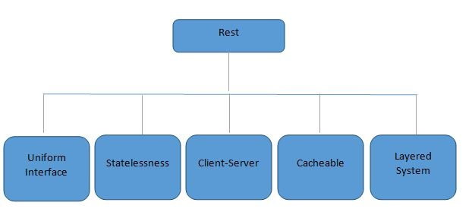
RESTful API (REST API)
Constraints of REST
A Restful system should follow the constrains so it can be called Restful. There are 5 and 1 optional constraints of REST.

Slide 6
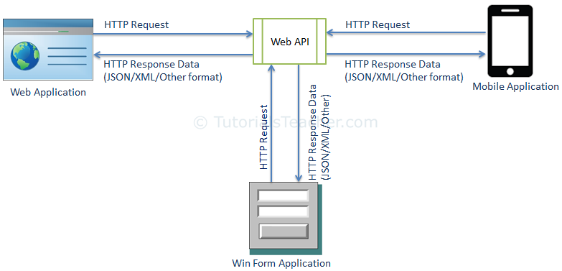
Usage
The ASP.NET Web API is an extensible framework for building HTTP based services that can be accessed in different applications on different platforms such as web, windows, mobile etc.
It works more or less the same way as ASP.NET MVC web application except that it sends data as a response instead of html view.
It is like a webservice or WCF service but the exception is that it only supports HTTP protocol.

Slide 7
ASP.NET Web API Characteristics
ASP.NET Web API is an ideal platform for building RESTful services.
ASP.NET Web API is built on top of ASP.NET and supports ASP.NET request/response pipeline
ASP.NET Web API maps HTTP verbs to method names.
ASP.NET Web API supports different formats of response data. Built-in support for JSON, XML, BSON format.
ASP.NET Web API can be hosted in IIS, Self-hosted or other web server that supports .NET 4.0+.
ASP.NET Web API framework includes new HttpClient to communicate with Web API server. HttpClient can be used in ASP.MVC server side, Windows Form application, Console application or other apps.

Slide 8
ASP.NET Web API Versions
Web API Version | Supported .NET Framework | Coincides with | Supported in
Web API 1.0 | .NET Framework 4.0 | ASP.NET MVC 4 | VS 2010
Web API 2 - Current | .NET Framework 4.5 | ASP.NET MVC 5 | VS 2012, 2013, 2015, 2017, 2019

Slide 9
HTTP Status code
200 - OK
201 - Created
204 - No Content
400 - Bad Request
401 - Unauthorized
404 - Not Found
409 - Conflict (if resource already exists.)
500 - Internal Server Error

Slide 10
HTTP Verbs
Http verbs plays a very important role in the Restful Web API. The most common Http verbs are GET, PUT, POST and DELETE and these correspond to CRUD (Create, Read, Update and Delete) operations respectively.
The following Http Verbs exists:
GET
POST
PUT
DELETE
Options

Slide 11
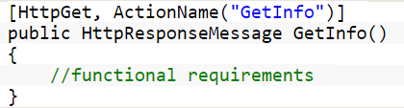
HTTP Verbs
GET
As the name specifies, this verb is used to retrieve the data or information. It does not have any other effect except getting data.
Syntax
[HttpGet]
We can use the above syntax to define the method as a GET method. If we are retrieving the data from the database or displaying the data, then we can use this attribute to get the data.
Use
Call
Request URL : http://localhost:56828/api/sample/GetInfo
By the help of above Requested URI, we can get the information. Sample is the controller name.

Slide 12
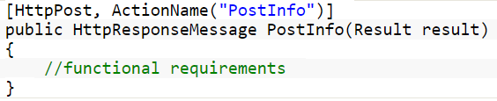
HTTP Verbs
POST
This verb is used to generate or create the resource. For example, If we have to add some information to the database then we must define the method as a POST method. The most common form to submit the data into the POST method is to pass the data into any entity object.
Syntax
[HttpPost]
We can use the above syntax to define the method as a POST method.
Use
Call
In the above example there is a method named PostInfo which is defined as POST method. We have to assign the data to the properties of the entity (Result class).

Slide 13
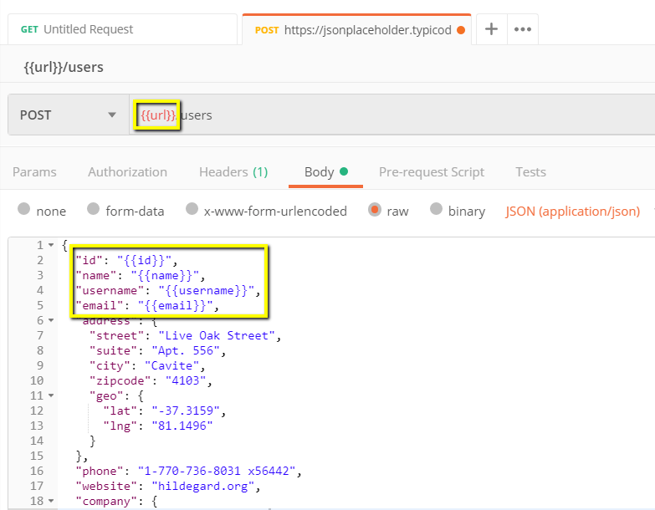
HTTP Verbs
POST

Slide 14
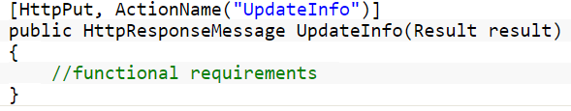
HTTP Verbs
PUT
This verb is used to update the existing resource. For example, If we have to update some information to the database then we can define the method as a PUT method. We can send the data in the form of object as well as in a parameter too.
Syntax
[HttpPut]
We can use the above syntax to define the method as a PUT method.
Use
In the above example there is a method as named UpdateInfo which is defined as PUT method. We can assign the id to update the info.

Slide 15
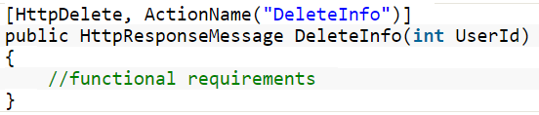
HTTP Verbs
DELETE
This verb is used to delete the existing resource. For example, If we have to delete some information to the database then we can define the method as a DELETE method. We can send the data in the form of object as well as in a parameter too.
Syntax
[HttpDelete]
We can use the above syntax to define the method as a DELETE method.
Use
In the above example there is a method named DeleteInfo which is defined as DELETE method. We can assign the id to delete the info.

Slide 16
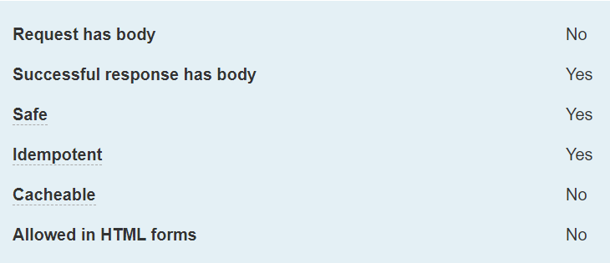
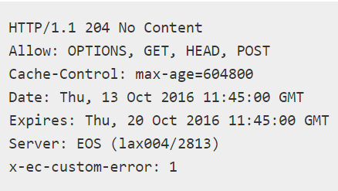
HTTP Verbs
OPTIONS
The HTTP OPTIONS method is used to describe the communication options for the target resource. The client can specify a URL for the OPTIONS method, or an asterisk (*) to refer to the entire server.
Syntax
OPTIONS /index.html HTTP/1.1
OPTIONS * HTTP/1.1

Slide 17
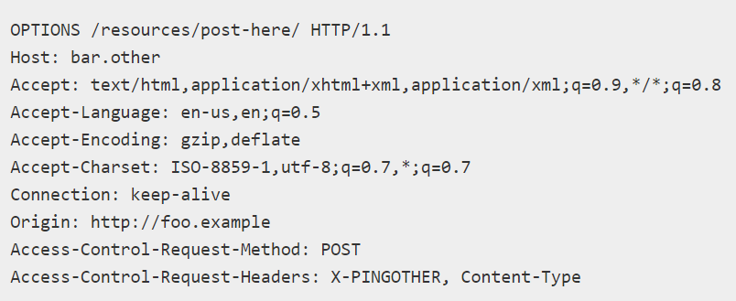
Preflighted requests in CORS
In CORS, a preflight request with the OPTIONS method is sent, so that the server can respond whether it is acceptable to send the request with these parameters.
The Access-Control-Request-Method header notifies the server as part of a preflight request that when the actual request is sent, it will be sent with a POST request method.
The Access-Control-Request-Headers header notifies the server that when the actual request is sent, it will be sent with a X-PINGOTHER and Content-Type custom headers. The server now has an opportunity to determine whether it wishes to accept a request under these circumstances.

Slide 18
HTTP Verbs example
HTTP Verb | CRUD | URL | Description
GET | Read | /api/customers /api/customers/1 | Returns all customers Returns details of customer ID 1
POST | Create | /api/customers | Create new customer
PUT | Update | /api/customers/1 | Update customer detail
DELETE | Delete | /api/customers/1 | Delete customer
OPTIONS |  |  | List the allowed operations on a resource. OPTIONS requests are what we call pre-flight requests in Cross-origin resource sharing (CORS). For e.g. Access-Control-Allow-Origin: *
HEAD |  |  | Return only the response headers and no response body.

Slide 19
URL - Uniform Resource Locator
Protocol
Domain
Path
Querystring
https://www.google.com/search?q=web+api

Slide 20
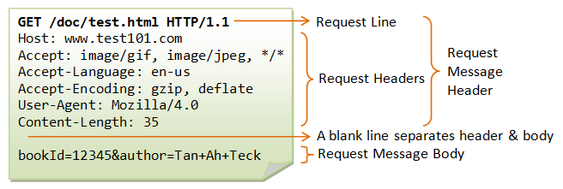
HTTP Request
URL
Header
Body

Slide 21
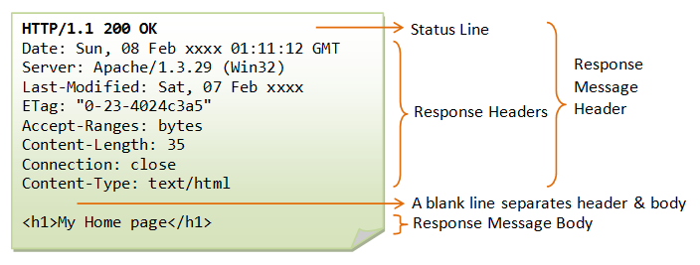
HTTP Response
Status
Header
Body

Slide 22
What Is the Difference Between HTTP and HTTPS?
What is HTTP?
HTTP stands for Hypertext Transfer Protocol. When you enter http:// in your address bar in front of the domain, it tells the browser to connect over HTTP. HTTP uses TCP (Transmission Control Protocol), generally over port 80, to send and receive data packets over the web. To put it simply it is a protocol that’s used by a client and server which allows you to communicate with other websites. The client sends a request message to an HTTP server (after the TCP handshake) which hosts a website, the server then replies with the response message. The response message contains completion status information, such as “HTTP/1.1 200 OK”.
What is HTTPS?
HTTPS stands for Hypertext Transfer Protocol Secure (also referred to as HTTP over TLS or HTTP over SSL). When you enter https:// in your address bar in front of the domain, it tells the browser to connect over HTTPS. Generally sites running over HTTPS will have a redirect in place so even if you type in http:// it will redirect to deliver over a secured connection. HTTPS also uses TCP (Transmission Control Protocol) to send and receive data packets, but it does so over port 443, within a connection encrypted by Transport Layer Security (TLS).

Slide 23
Creation of APIs
Following software are required to build Web API Application:
Visual Studio 2017/2019
Web API 2
Notes:
Create new WEB API project : https://docs.microsoft.com/en-us/aspnet/web-api/overview/getting-started-with-aspnet-web-api/tutorial-your-first-web-api

Slide 24
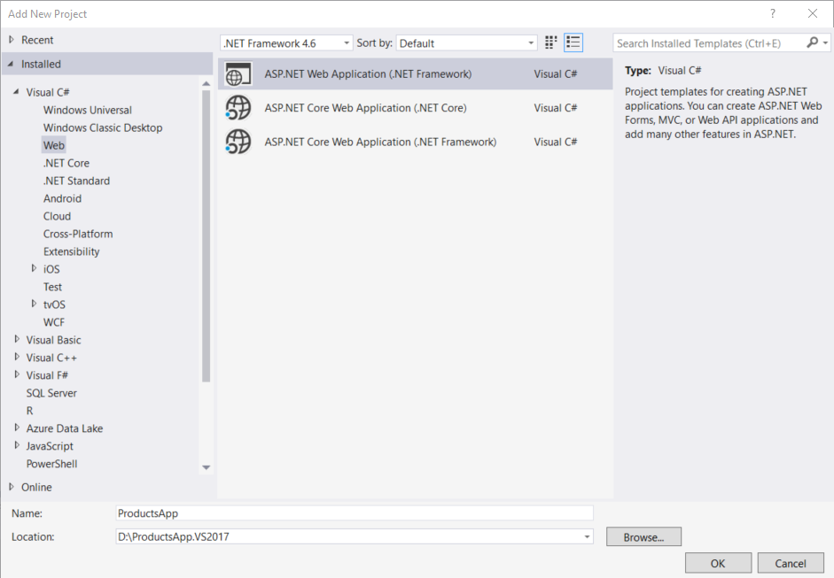
Create a Web API Project
Start Visual Studio and select New Project from the Start page. Or, from the File menu, select New and then Project.
In the Templates pane, select Installed Templates and expand the Visual C# node. Under Visual C#, select Web. In the list of project templates, select ASP.NET Web Application. Name the project "ProductsApp" and click OK.

Slide 25
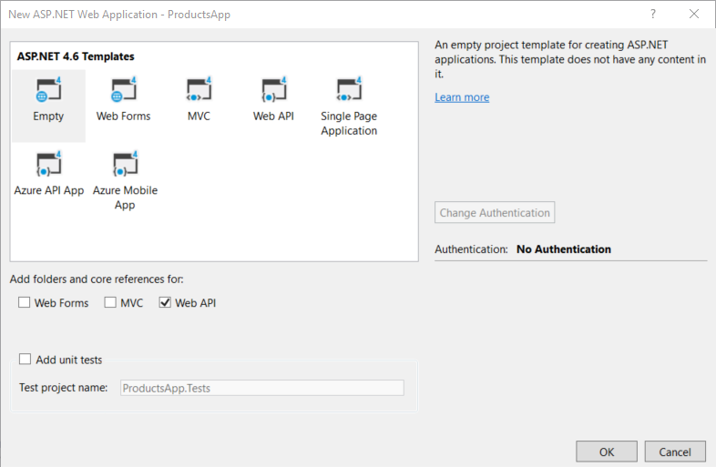
In the New ASP.NET Project dialog, select the Empty template. Under "Add folders and core references for", check Web API. Click OK.

Slide 26
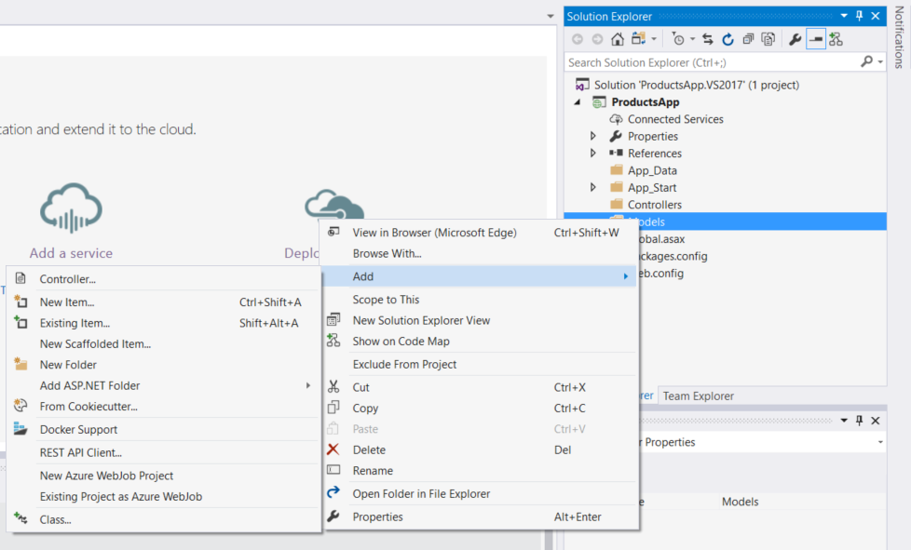
Adding a Model
A model is an object that represents the data in your application. ASP.NET Web API can automatically serialize your model to JSON, XML, or some other format, and then write the serialized data into the body of the HTTP response message.
If Solution Explorer is not already visible, click the View menu and select Solution Explorer. In Solution Explorer, right-click the Models folder. From the context menu, select Add then select Class.

Slide 27
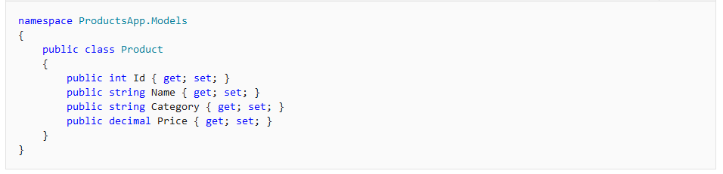
Name the class "Product". Add the following properties to the Product class.

Slide 28
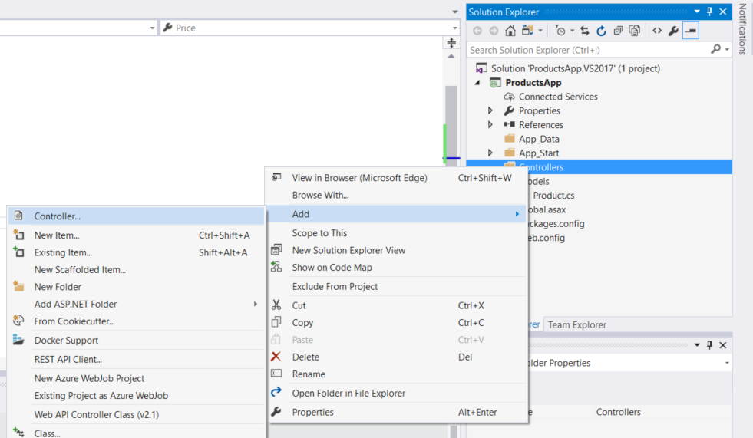
Adding a Controller
In Web API, a controller is an object that handles HTTP requests. We'll add a controller that can return either a list of products or a single product specified by ID.
If you have used ASP.NET MVC, you are already familiar with controllers. Web API controllers are similar to MVC controllers, but inherit the ApiController class instead of the Controller class.
In Solution Explorer, right-click the Controllers folder. Select Add and then select Controller.

Slide 29
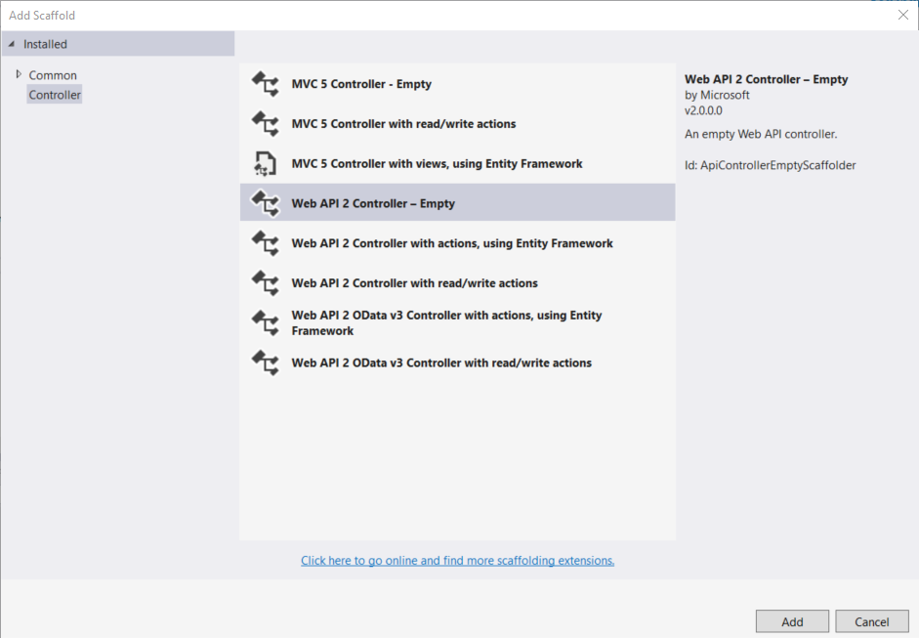
In the Add Scaffold dialog, select Web API Controller - Empty. Click Add.

Slide 30
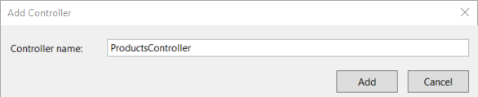
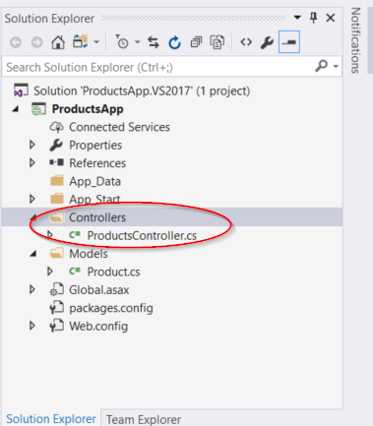
In the Add Controller dialog, name the controller "ProductsController". Click Add.
The scaffolding creates a file named ProductsController.cs in the Controllers folder.

Slide 31
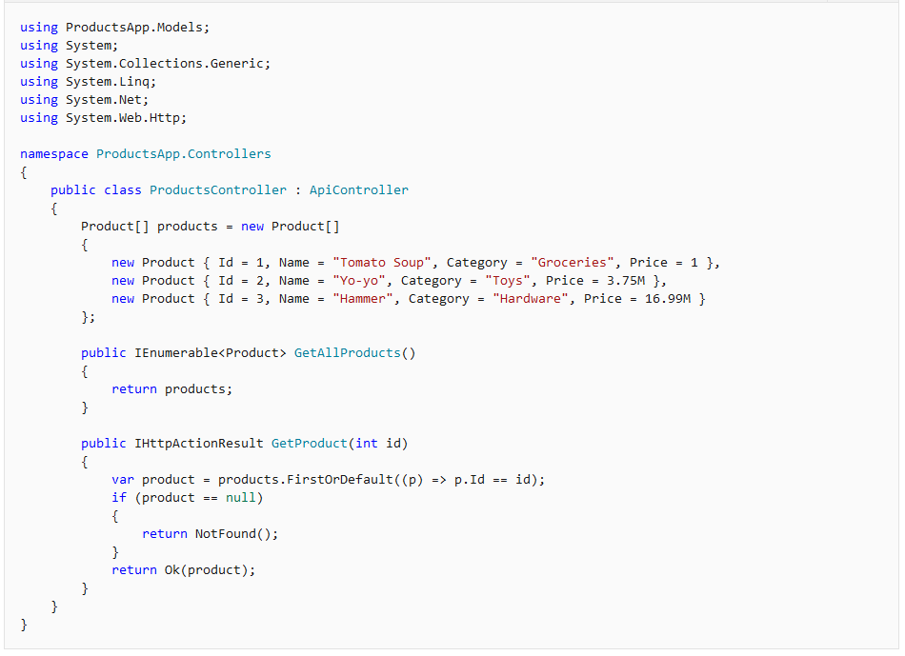

Slide 32
The controller defines two methods that return products:
The GetAllProducts method returns the entire list of products as an IEnumerable<Product> type.
The GetProduct method looks up a single product by its ID.
Each method on the controller corresponds to one or more URIs:
Controller Method | URI
GetAllProducts | /api/products
GetProduct | /api/products/id
For the GetProduct method, the id in the URI is a placeholder. For example, to get the product with ID of 5, the URI is api/products/5.

Slide 33
Action Results
A Web API controller action can return any of the following:
Return type | How Web API creates the response
void | Return empty 204 (No Content)
HttpResponseMessage | Convert directly to an HTTP response message.
IHttpActionResult | Call ExecuteAsync to create an HttpResponseMessage, then convert to an HTTP response message.
Other type | Write the serialized return value into the response body; return 200 (OK).

Slide 34
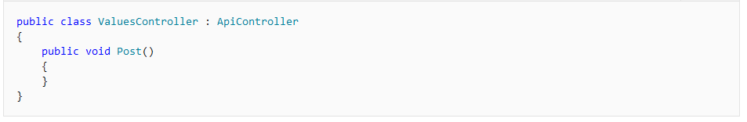
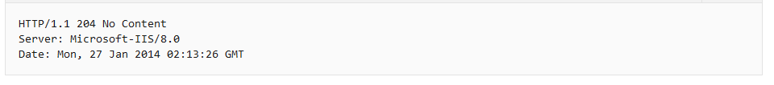
Void
If the return type is void, Web API simply returns an empty HTTP response with status code 204 (No Content).
Example controller:
HTTP response:

Slide 35
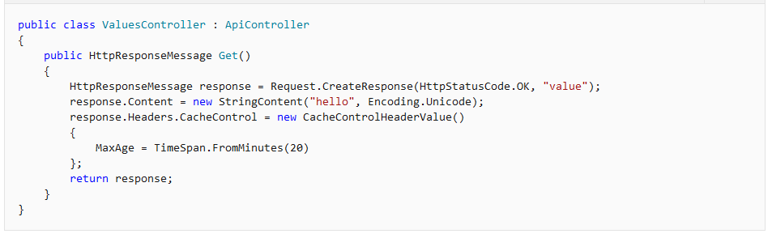
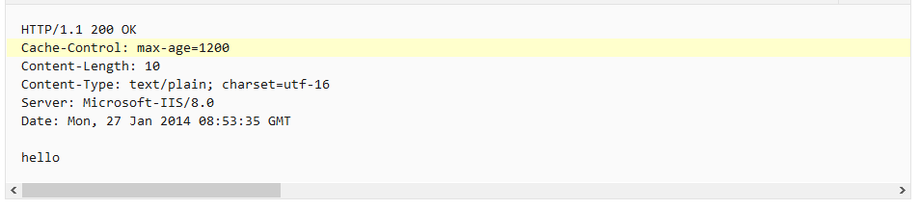
HttpResponseMessage
This option gives you a lot of control over the response message. For example, the following controller action sets the Cache-Control header.
Response:

Slide 36
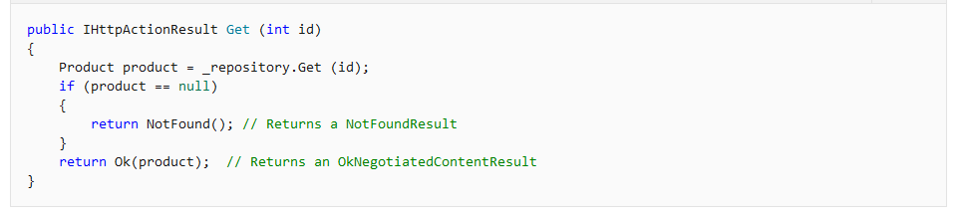
IHttpActionResult
The IHttpActionResult interface was introduced in Web API 2. Essentially, it defines an HttpResponseMessage factory. Here are some advantages of using the IHttpActionResult interface:
Simplifies unit testing your controllers.
Moves common logic for creating HTTP responses into separate classes.
Makes the intent of the controller action clearer, by hiding the low-level details of constructing the response.
In the following example, if the request does not match an existing product ID, the controller calls ApiController.NotFound to create a 404 (Not Found) response. Otherwise, the controller calls ApiController.OK, which creates a 200 (OK) response that contains the product.

Slide 37
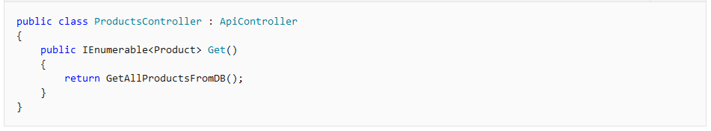
Other Return Types
For all other return types, Web API uses a media formatter to serialize the return value. Web API writes the serialized value into the response body. The response status code is 200 (OK).
A disadvantage of this approach is that you cannot directly return an error code, such as 404. However, you can throw an HttpResponseException for error codes.

Slide 38
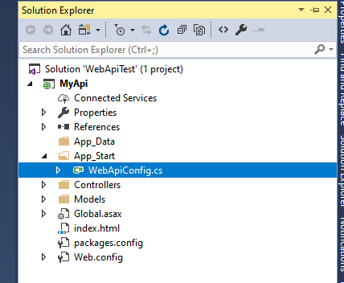
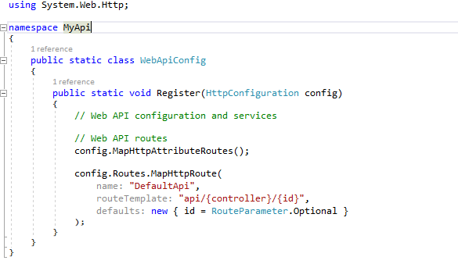
Routing in ASP.NET Web API
In ASP.NET Web API, a controller is a class that handles HTTP requests. The public methods of the controller are called action methods or simply actions. When the Web API framework receives a request, it routes the request to an action.
To determine which action to invoke, the framework uses a routing table. The Visual Studio project template for Web API creates a default route:
This route is defined in the WebApiConfig.cs file, which is placed in the App_Start directory:

Slide 39
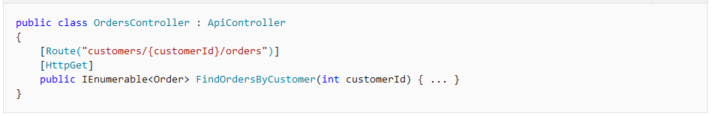
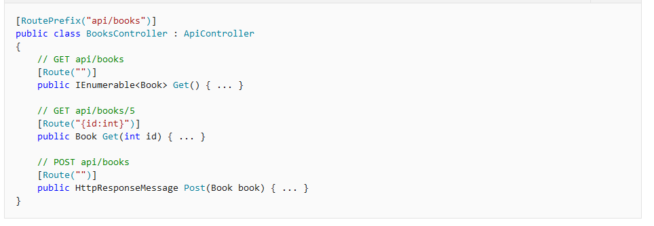
Attribute Routing in ASP.NET Web API 2
Here is an example of a route defined using an attribute:

Slide 40




THANK YOU
HEAD OFFICE:
B/81, Corporate House, Judges Bunglow Road,
Bodakdev, Ahmedabad - 380054. India.
+91 79 2685 2554 / 55 / 56
gateway@thegatewaycorp.com
WWW.THEGATEWAYCORP.COM

